Slide 1
Reminders
Please mute your phone lines
This session is being recorded
Notes:
Roll Call for people on the phone but not on Blackboard Collaborate

Slide 2
State Health Assessment and State Health Improvement Plan: Planning Council Introductory Meeting
Presented by:
Illinois Governor’s Office, Department of Public Health
and the
University of Illinois at Chicago School of Public Health
June 15, 2015

Slide 3
Today’s Agenda
Introductions and Welcome
Overview of the assessment and planning process
Engagement
Assessment
Planning
State Innovation Model
Review Roles and Responsibilities
SHIP Member Questions
Action Steps and Next Meeting
Public Comment
Adjourn

Slide 4

Today’s purpose
Notes:
Describe the purpose of the State Health Assessment and State Health Improvement Plan
Share the overall planning process and timeline
Present Planning Council roles in the overall process

Slide 5
What is a SHA and SHIP?
State Health Assessment or SHA:
Systematic approach to collecting, analyzing, and using data to educate and mobilize communities, develop priorities, garner resources, and plan actions to improve the public’s health.
State Health Improvement Plan or SHIP:
Long-term systematic plan to address issues identified in the SHA. Describes how the state health department and the communities it serves will work together to improve the health of the population.
Notes:
A state health assessment is a systematic approach to collecting, analyzing, and using data to educate and mobilize communities, develop priorities, garner resources, and plan actions to improve the public’s health.
A state health improvement plan (SHIP) is a long-term systematic plan to address issues identified in the state health assessment. A SHIP describes how the state health department and the communities it serves will work together to improve the health of the population.

Slide 6
Why do a SHA and SHIP?
Assess the needs, assets, and opportunities of health of the public to assure strategies drive health improvement.
Illinois statute requires the production of a SHIP; specific focus on prevention and elimination of health disparities.
Notes:
Important approach to achieve core functions of the Department of Public Health including assessing the needs, assets, and opportunities of the health of the public to assure programming and policy strategies drive health improvement.
Illinois statute, 20 ILCS 5/5-565, requires the production of a SHIP examining public and private sector strategies for improving health status and the public health system specifically in areas of prevention and elimination of health disparities

Slide 7
Why do a SHA and SHIP?
Prerequisites of accreditation
Standards require specific criteria are met by the SHA and SHIP:
Health profile updated annually that shows Illinois’ state of health
Engagement and review of the data by stakeholders
Action plans linked to priorities and progress on the plan implementation
Monitoring of health and actions to the IDPH’s strategic plan and quality improvement system
Notes:
SHA and SHIP are prerequisites of voluntary accreditation, and several standards require specific criteria are met within the SHA and SHIP. These include but are not limited to:
A health profile updated annually that shows Illinois’ state of health including comparison, trend and disparity data
Engagement and review of the data by stakeholders
Action plans linked to identified priorities and reported progress on the plan implementation
A link in the monitoring of the health and health actions to the IDPH’s strategic plan and quality improvement system

Slide 8
What is required for a SHA and SHIP?
State Board of Health and Department of Public Health responsible for producing plan.
Recommendations delivered to the governor
Planning Council from public, private, and voluntary sector stakeholders and participants in public health system.
Consideration of priorities and strategies developed at the local and regional level.
Three public hearings held across the state on the drafts of each plan.
Notes:
Responsibility for producing the plan lies with the State Board of Health, and the Illinois Department of Public Health which appoints a planning team that includes a range of public, private, and voluntary sector stakeholders and participants in the public health system.
Plans must be delivered to the governor each January 1 of 2006, 2009, 2016 and every 5 years thereafter.
Plans must take into consideration public health priorities and strategies developed at the local and regional level.
Three public hearing on the drafts of each plan must be held across the state.
Evidence must be collected to show that data were available and reviewed by the public.

Slide 9
Current state of the SHIP
Last assessment and planning process completed in 2010. Next SHA and SHIP are due 2016.
Successes toward implementation have included:
Performance measures
Public information campaign for organizations to demonstrate alignment with the SHIP
State Health Transformation Summits
Notes:
The last assessment and planning process was completed in 2010 and according to statute, the next SHA and SHIP are due 2016.
Successes toward implementation have included:
Development of performance measures of the plan;
A public information campaign for organizations to demonstrate their alignment with the SHIP priorities; and
State Health Transformation Summits in which over 700 residents and organizations discussed the state of the health system in Illinois.

Slide 10
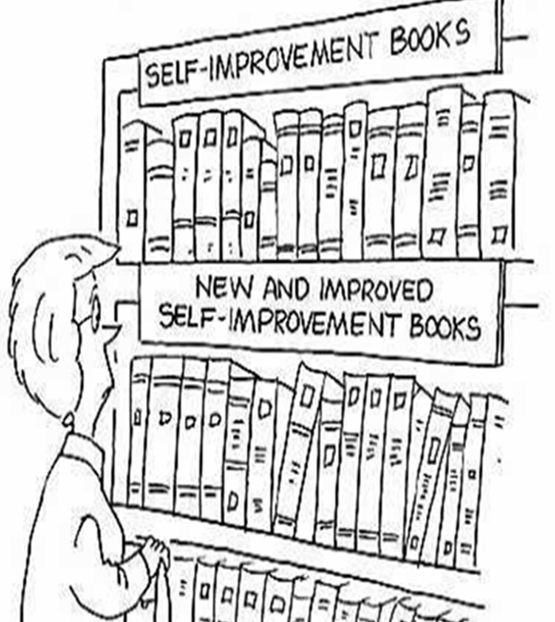
2015-2016 concepts to consider
Maximize existing assessment data and effectively use resources
Documentation to meet accreditation criteria
Design process to facilitate implementation and action
Build from past experiences and expertise
Demonstrate integration of primary prevention and clinical care
Promote measurement and reporting of system progress
Notes:
Maximize existing assessment data and effectively use resources
Provide documentation to meet accreditation criteria related to SHA/SHIP
Design SHA/SHIP process to facilitate implementation and action
Build from past experiences and expertise
Demonstrate integration of primary prevention and clinical care in assessment, planning and implementation activities
Promote measurement and reporting of system progress

Slide 11
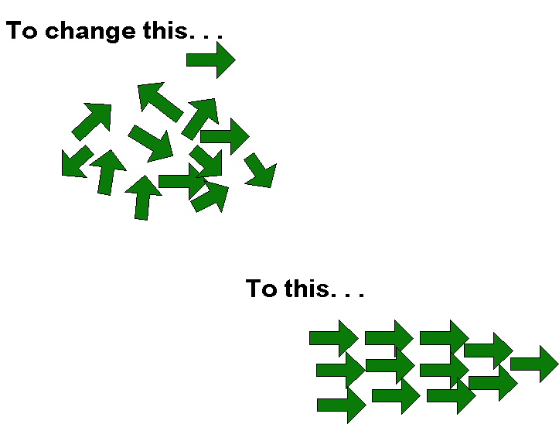
The basic planning process

Slide 12
The basic planning process
A. Where are you?
B. Where you want to be?
C. How to get there…

Slide 13
The basic planning process
Future State:
Where do we want to be?
Current state:
Where are we now?
Strategies and actions:
How do we get there?
Where are we now? What is the situation?
What are our strengths? What are our resources? What are our limitations?
What are opportunities?
What are threats?
Select strategies based on best options
Selection helps to focus the work based on resources and leverage points
Where do we want to be?
How will we know we’re successful?
What are our measures of success?
How will we measure progress?
Notes:
To prevent duplication and promote coordination

Slide 14
Planning in a nutshell
“Vision without action is merely a dream. Action without vision just passes the time. Vision with action can change the world.”
~ J.A. Barker

Slide 15
Overall SHA/SHIP Steps
Engage stakeholders
Conduct a state health assessment:
Collect and analyze data
Collect and analyze feedback
Review and decide health priorities
Facilitate state health improvement planning:
Create action plans and performance monitoring approaches
Obtain feedback and approval; align organizational work with the plan
Launch the plan and track progress

Slide 16
Stakeholder Engagement
UIC SPH & IDPH Team
Executive Committee
Data and measurement team
Organizational members &
public residents
SHIP Planning Council
Organizational members &
public residents
State government agencies
Training
Health priority lead organizations
Communi-
cations
Local Health Department membership organizations
Statewide minority organizations
Data Utilization
Decision making
Healthcare system representatives
Multi-sectoral groups
Statewide Action Teams
Statewide Action Teams
Statewide Action Teams
Aligned and coordinated activities around state and RHN plans
Health improvement and increased health equity

Slide 17
Overall SHA/SHIP Steps
Engage stakeholders
Conduct a state health assessment:
Collect and analyze data
Collect and analyze feedback
Review and decide health priorities
Facilitate state health improvement planning:
Create action plans and performance monitoring approaches
Obtain feedback and approval; align organizational work with the plan
Launch the plan and track progress

Slide 18
What data will be collected?
Health Priorities
"How healthy are our residents?" and "What does the health status of our state look like?”
Forces of change
"What is occurring or might occur that affects the health of our state?" and "What specific threats or opportunities are generated by these occurrences?”
Themes and Strengths
“What is important to the state?”, “How is quality of life perceived in the state?” and “What assets exist that can be used to improve health in the state?”
Health system assessment
"What are the components, activities, competencies and capacities of our public health system?" and "How are the Essential Services being provided to our state?”
“To what degree are you satisfied with IDPH/ health system’s performance on NPHPS?”
Notes:
PHAB requires use of a recognized planning process and we will use the Mobilizing Action with Partnerships and Planning or MAPP, developed by the National Association of County and City Health Officials (NACCHO) and used by most state and local health departments for SHA/SHIP work.
There are 4 primary assessments within this model and they include the following.

Slide 19
Notes:
Visual description of assessments

Slide 20
SHA steps
Collect and analyze data from statewide partner reports and IDPH
Interview Planning Council for their perceptions of the State of Health
Review findings after first two meetings of the Planning Council and create early State of Health presentation.
Collect additional stakeholder feedback:
Focus groups across the state
Organizational presentations on State of Health
Webinars
Public posting on website
Analyze and present findings to the Planning Council.
Finalize priorities and write final SHA.
Notes:
Collect and analyze existing data from statewide partner reports and IDPH mortality, morbidity, risk factor, social determinants of health, and demographic data to matriculate the data for the 4 assessments.
Interview Planning Council for their perceptions of the State of Health based on the 4 assessments.
Review findings after first two meetings of the Planning Council and create early State of Health presentation.
With Planning Council, collect additional stakeholder feedback: Conduct 5 focus groups across the state, approximately 10 organizational presentations on State of Health, two webinars, and post the information on the website for feedback.
Analyze and presenting additional findings to the Planning Council.
Finalize priorities and write final SHA.

Slide 21
Community Health Assessment Data
Types of assessment needed | Proposed data sources
Health priority status | Based on nationally comparable indicators, present morbidity and mortality data; risk factor data; social determinants of health including income, education, and healthcare access data. IPLAN assessments/CHNA assessments and comparisons Planning Council interviews and meetings; and focus groups and organizational presentations.
Community Themes and Strengths | Existing statewide reports and documents relevant to health Planning Council interviews and meetings; and focus groups and organizational presentations.
Health Systems Data | IDPH Satisfaction Survey organized around the National Public Health Performance Standards, Year 1 and 2 data; Planning Council interviews and meetings; and focus groups and organizational presentations.
Forces of Change | Existing statewide reports and documents relevant to health Planning Council interviews and meetings; and focus groups and organizational presentations.

Slide 22
Sample Core Health Indicators Balanced Portfolio Examples
Health Area | Clinical Approaches | Community Approaches | Clinical Measures | Community Measure
Smoking (short-term) | Screenings E-referral Medication | Quitline Smoke-free public places and multiunit housing Enforcement of sales Media & education campaigns | Tobacco use assessment Tobacco cessation intervention (Source: EHR) | Smoking rates, adults (BRFSS) Smoking rates, adolescents (YRBS) Quit rates (BRFSS) Quitline utilization
 | Support Health Collaborative Multidisciplinary team-based care, including CHW
Asthma (intermediate-term) | Guideline based diagnosis, care and treatment, including Action plans for all patients | Home visits: Environmental interventions (dust mites, etc) School nurse f/u | Asthma assessment Use of appropriate medications Influenza vaccination rates (Source: EHR) | ED visits (syndromic surveillance) ED visit and Hospitalizations and costs Avoidable ED visits (HHDB/AHRQ algorithm) Asthma attacks, asthma related missed school and activity limitation (BRFSS asthma call-back survey)
 | Multidisciplinary team-based education and care, including CHW, clinical telephonic consultation
Notes:
Healthy Illinois will be required to have, what we are calling, a balanced portfolio….the portfolio should be balanced in terms of the time line of interventions and their impact-e.g. short, medium, and long term, as well as in their risk…(lower risk .e.g evidence based interventions…and higher risk (e.g best practices and innovative approaches that may have tremendous impact, but are not yet supported by the highest levels of evidence.
For example, in the area of childhood asthma, Healthy Illinois triple aim activities would be aimed at improved quality of care, decreased hospitalization costs, and improved quality of life (better sleep, more active) and health for asthma patients in individual health plans as well as the community as a whole

Slide 23
Planning Steps
Engage stakeholders
State health assessment:
Collect and analyze data
Collect and analyze feedback
Review and decide health priorities
State health improvement plan:
Create action plans and performance monitoring approaches
Obtain feedback and approval; align organizational work with the plan
Launch the plan and track progress

Slide 24
SHIP steps
Final selection of health priorities for action.
Develop resource of interventions to guide action planning.
Assign working groups to health priority teams and develop an action plan.
Review and revise action plans with Planning Council. Obtain commitment for action.
Finalize and hold three public hearings.
Submit final plans to State Board of Health and Governor’s Office.
Notes:
Facilitate final selection of health priorities for action.
Develop resource of evidence and asset-based interventions to guide action planning.
Assign working groups to each health priority team to develop an action plan based on: evidence-based activities; statewide assets and resources; and organizational alignments.
Review and revise action plans with Planning Council. Obtain commitment for action.
Finalize and hold three public hearings.
Submit final plans to State Board of Health and Governor’s Office.

Slide 25
Brief State Innovation Model (SIM) Overview
Overview of SIM
SIM History in Illinois
Illinois Current Approach to the SIM

Slide 26
SIM Funding - CMMI
Financial and technical support for state-led projects seeking to achieve:
Multi-payer health care payment and service delivery models
Improved health system performance, increase quality of care and reduced costs
Impacting all state residents

Slide 27
SIM History in Illinois
In 2013, Illinois received $2.5 million dollars for a six month planning effort which created the Alliance for Health Plan
The previous Administration created the Governor’s Office of Health Innovation and Transformation through executive order
In the summer of 2014, hundreds of stakeholders participated in workgroup meetings producing recommendations for implementation
Illinois applied for $98 million model test funding
Illinois received a continued planning grant for $3 million

Slide 28
Challenges/Barriers of Previous SIM Efforts
Stakeholder Fatigue
Lack of Payer Engagement
Lack of Operational Plan
Lack of Focused Strategic Vision

Slide 29
SIM Opportunities with a Refreshed Administration
Create a clear pragmatic, “do-able” vision
Align and engage State Agency Leadership early – and truly align state efforts
Reduce duplicative efforts that waste time and resources

Slide 30
Illinois’ State Innovation Model Healthy Illinois
By 2016, Illinois will build a framework for a robust and sustainable value-based healthcare system, that will allow for:
The majority of patients to receive care that is patient-centered and coordinated across settings.
The development of measures and the alignment of incentives across payers to improve clinical outcomes, and reduce costs.
A culture of innovation and collaboration through the engagement of the Regional Health Networks (RHNs) to share best practices, foster rapid cycle improvement and improve local efforts.
DRAFT

Slide 31
Healthy Illinois: Improving Quality, Reducing Costs, and Community-Driven
Executive Leadership Committee:
Governor's Office, Illinois Department of Public Health, Illinois Department of Healthcare and Family Services, Illinois Department of Insurance, Department of Human Services, and llinois Department on Aging
SIM Action Team:
Healthcare providers/ systems, commercial payers/purchasers, state hospital and medical associations, community-based and long-term support providers, consumer advocacy organizations, social service organizations, and state agencies
SHIP ICC:
State government agencies, local health department membership organziations, healthcare providers/ systems, health priority lead organizations, statewide minority organziations, higher education, and multi-sectoral groups
Action Teams
Regional Health Networks
Key Focus Area Teams
DRAFT
Illinois Health Innovation Transformation Plan
- SIM Action Plan
Implementation Plan for Key Focus Areas
- State Health Improvement Plan
Plan for Population Health
State Health Assessment
-1115 Waiver

Slide 32
Illinois’ State Health Assessment and Plan for Population Health Improvement Timeline
Phases | Basic activities
Phase 1: April – May 2015 | Conduct primary and secondary data analysis for SHA
Phase 2: May-June 2015 | Engage Planning Council members Assess data, indicators and measure availability
Phase 3: June –July 2015 | Facilitate Planning Council review of data toward draft priorities, develop strategic approach, and align organizational strengths
Phase 4: August – September 2015 | Conduct focus groups and continued organizational feedback sessions Analyze results of vetting process statewide
Phase 5: October – December 2015 | Planning Council reviews SHA Undertake action planning
Phase 6: January - February 2016 | Submit final draft of the SHA Review and revise actions plans with Planning Council
Phase 7: February – March 2016 | Public commentary on SHIP Revise SHIP per feedback
Phase 8: April 2016 | SHIP Plans submitted for final approval
Notes:
Talking Points for Phase 3:
Introduction the overall process and its purpose
Introduce and discuss the role of the Planning Council
Present findings from data from each of the 4 assessments
Obtain feedback from Planning Council for each of the assessments
Facilitate early understanding of vision
Engage the Planning Council to participate in the focus group and presentation process

Slide 33
Assessment and planning process
Phase 1
Health Priority Status
Community Themes and Strengths
Health Systems Change
Forces of Change
Collect primary data and conduct secondary data analysis
Phase 2
Planning Council reviews data and decides early findings and vision
Data and measurement team
Statewide Vision for Population Health Improvement Proposed
SHA data
SHA data
SHA data
SHA data
Phase 3
Focus groups and organizational presentations occur; data, indicators, and measures are presented; and findings are summarized into final SHA document that is aligned with RHN plans
Phase 4 & 5
Planning Council reviews SHA; decides SHIP priorities; works to align priorities; and develops action plans
Statewide Action Teams
Statewide Action Teams
Statewide Action Teams
Phase 6 & 7
Planning Council finalizes statewide plans; Public hearings occur; and Board of Health reviews and recommends the final documents
Plans submitted and launched
Phase 8

Slide 34
SHIP Roles
Executive Leadership:
Lead the process through active participation and decision-making
MCPHP and DPH:
Design and facilitate all activities

Slide 35
Planning Council Roles/Responsibilities
Establish vision for health improvement
Actively provide input from organizational perspective or stakeholder affiliation, considering the entire state
Engage organizations as on the SHA and SHIP through presentations
Help to review data, organize community feedback, select priorities, align resources and assets, develop action plans, and assess progress
Select top health priorities and make recommendations on final SHA and SHIP
Review documents related to the SHA and SHIP
Align your organizational work and that of your partners to the action plans
Participate in “Action Teams” to develop action plans
Notes:
Establish a vision for health improvement in Illinois
Actively provide input on the SHA and SHIP from the perspective of the member’s organization or stakeholder affiliation, considering the entire state in the process.
Engage organizations across Illinois as presenters or speakers on the SHA and SHIP
Help to review data, organize community feedback, select priorities, align resources and assets, develop action plans, and assess progress
Select top health priorities for the state and make recommendations for the final SHA and SHIP products
Review documents related to the SHA and SHIP, including the final products
Align your organizational work and that of your partners to the action plans
Participate in “Action Teams” to develop action plans

Slide 36
Planning Council Next Steps
Upcoming meetings/interviews
Individual calls with Planning Council members
Monday, June 29, 1:00-4:30pm (Springfield)
Monday, July 13, 1:00-4:30 (Location, TBD)
Materials to receive soon
Bios/roster packet
Charter
Agenda for first meeting
Information re IL health priorities

Slide 37
Questions?
What questions do you have?
What is most clear about the process? What is unclear about the process?
What additional information do you need before the first meeting?
How else can we help you prepare for your role in the process?
Notes:
Please consider the following questions during our presentation. We will have several times for you to ask questions as well during the presentation itself.

Slide 38
Other resources
2010 IPLAN
Oklahoma SHIP
www.healthycommunities.illinois.gov
"Make no little plans. They have
no magic to stir
our blood... Make big plans;
aim high in hope and work."
~Daniel Burnham

